Slide 1

House Price Prediction
Machine Learning Project

Slide 2
Group members
Saurav Labade
Bushra Dosani
Ishu Gupta
Rajesh Sahoo

Slide 3

Introduction
Suppose you have a house and you want to sell it . Through House Price prediction project you can predict the price from previous sell history . And we make this predictions using Machine Learning Models
The dataset of this project contains house sale prices for King County, which includes Seattle. It includes homes sold between May 2014 and May 2015.
It has total 21613 rows and 21 colums.
.

Slide 4
Objectives
Perform univariate analysis by using statistical numerical data, histogram and distribution of numerical values.
Performing Bivariate analysis by using Pair plots , chi-square test and Pearson correlation.
Train multiple models like Linear Regression , Decision Tree, Random Forest.
Checking whether Linear regression is good or not.
Train a polynomial regression model with degree 2, and 3 and comparing its performance with other models.
Checking for multicollinearity using VIF.
After Checking Multicollinearity , remove columns with high multicollinearity.
Re-rull all the models and check the performance which is best.
Using grid search CV to tune the hyperparameter of the best model.

Slide 5
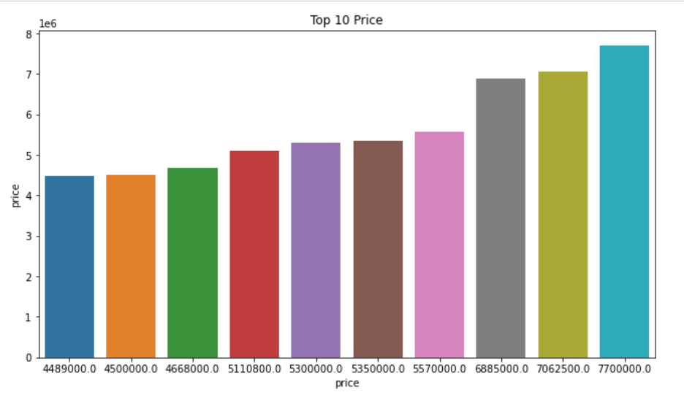
Top 10 price of house in Seattle

Slide 6
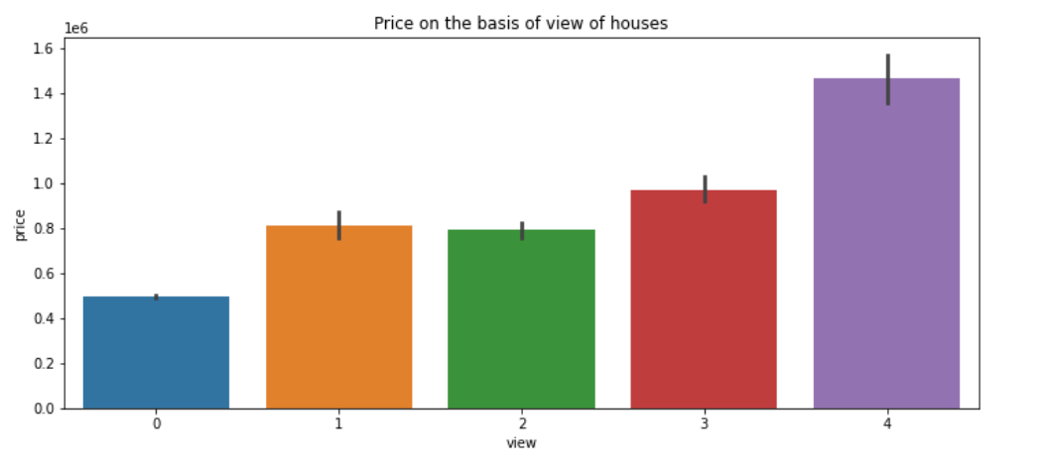
Price on the basis of the view

Slide 7
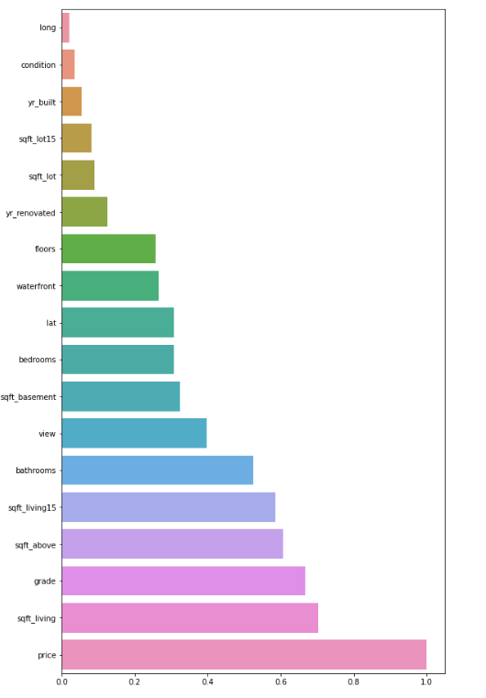
Multicollinearity.

Slide 8
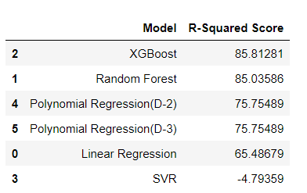
Model Comparison :

Slide 9
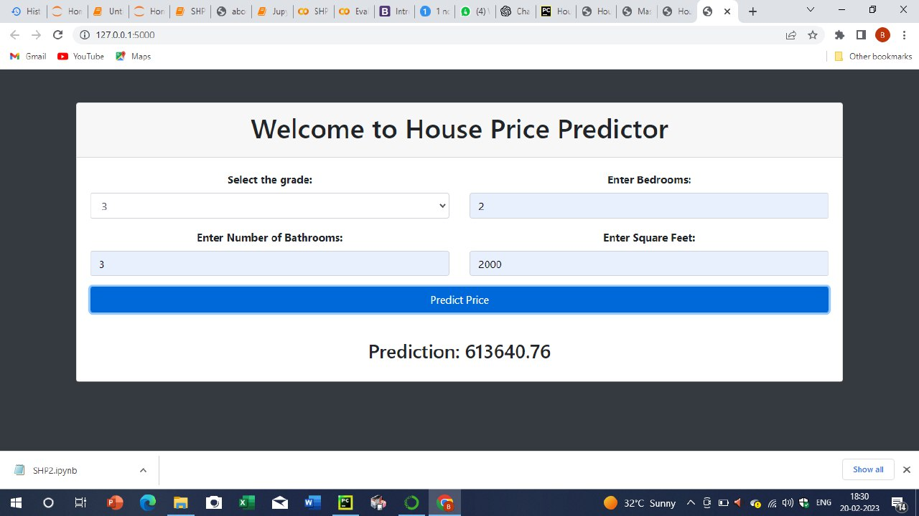

Slide 10
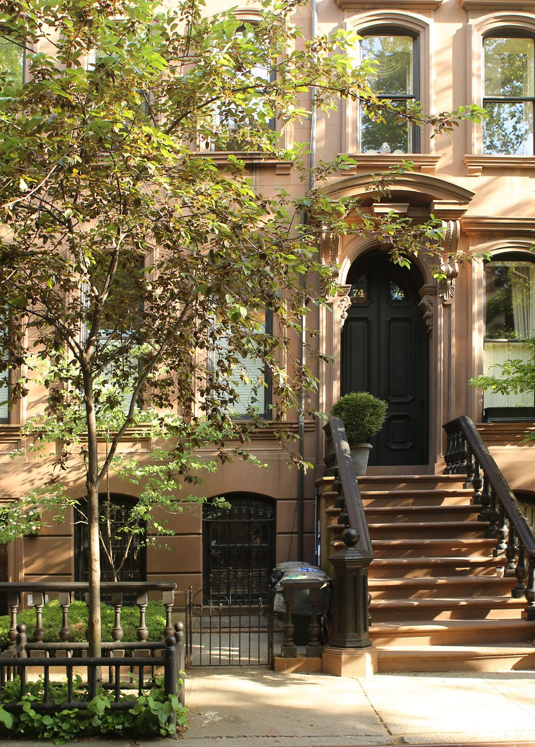
Conclusion
On an average the price of a house in Seattle is 540088.14177 and average bedrooms are 3.
As rating of view is increasing the price of house is also increasing.
The more bathrooms you have,the more expensive the property becomes.
The performance of random forest model is best as compare to the linear regression , polynomial regression and decision tree models.

Slide 11
Thank You

